Slide 1
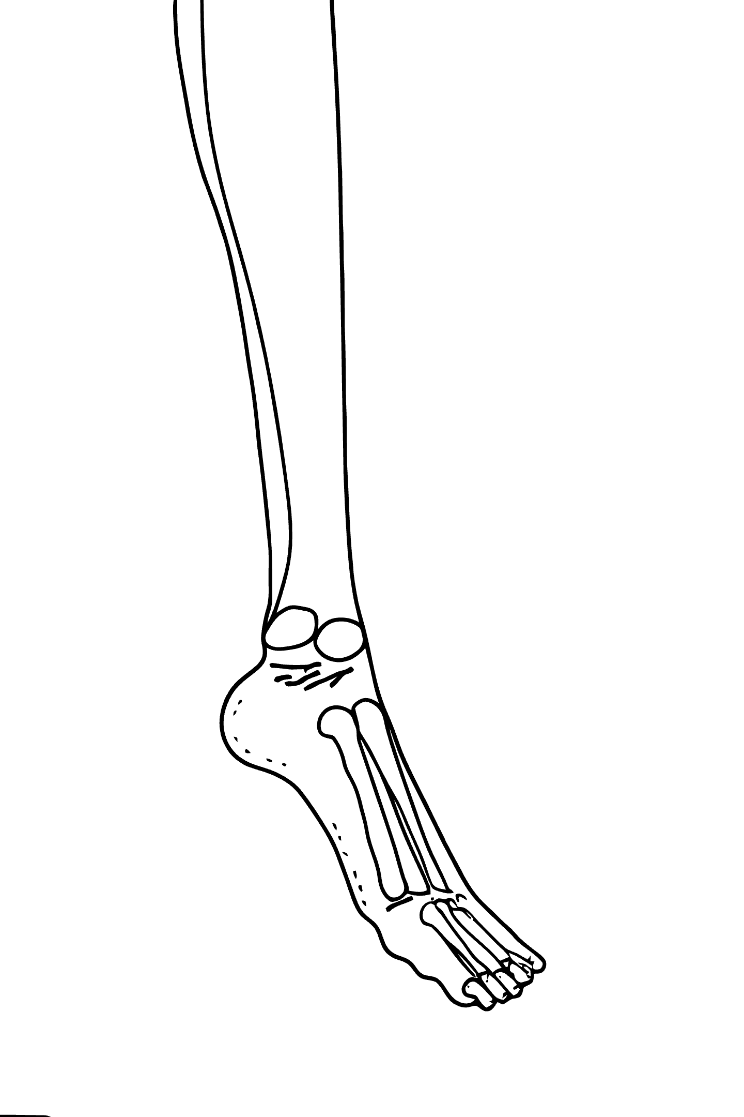
Diabetic Neuropathy Risk Prediction
Thermal Foot Image Analysis using Machine Learning
Department of Computer Science and Engineering (2025-26)

Slide 2

Project Team & Guide
Batch No: 49
Guide Name: Amaresh A M
Agasthya Samyak Jnan (02JST22UCS006)
Jayanth S (02JST22UCS043)
Arvind Ningombam (02JST22UCS017)
Prajwal T P (01JST21CS099)

Slide 3
Introduction: The DPN Challenge
Diabetic Peripheral Neuropathy (DPN)
Progressive Nerve Damage
Common, serious complication of long-term diabetes.
Affects sensory and autonomic nerves in feet/legs.
High Amputation Risk
Neuropathy implicated in most non-traumatic lower-limb amputations.

Slide 4
Thermal Imaging: A Promising Solution
Non-Invasive & Practical
Uses thermal camera for plantar foot thermogram.
Detects Abnormalities
Localized hot/cold spots indicate neuropathic/vascular issues.
Early Detection
Precedes visible skin breakdown, affordable, easy to implement.

Slide 5
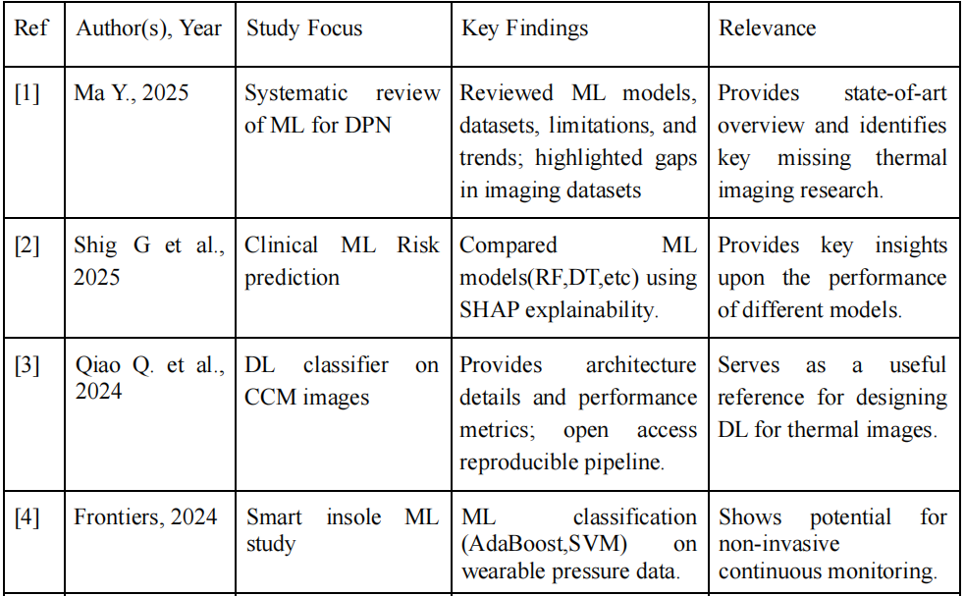
Literature Review

Slide 6
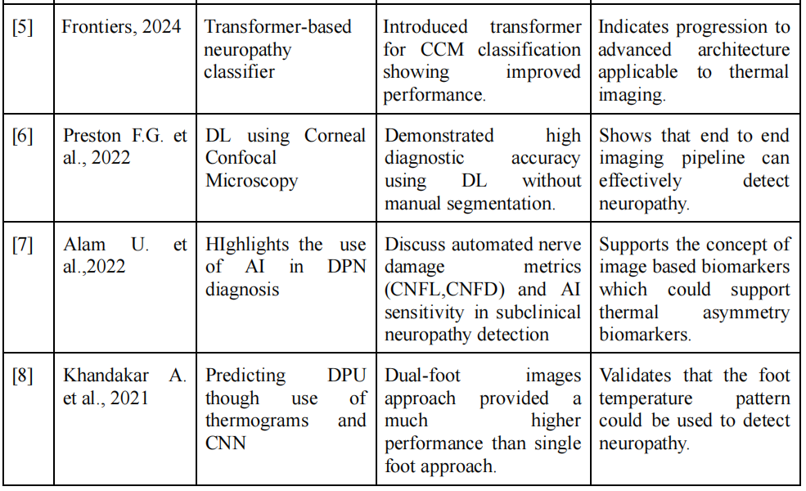
Literature Review

Slide 7
Limitations
Limited clinical diversity in the dataset.
Absence of direct neuropathy labels.
Small angiosome-annotated subset.
Thermal images are sensitive to environmental conditions.
Potential for overfitting due to limited subjects.
Lack of multimodal clinical data.

Slide 8
Project Objectives
To develop a Deep Learning based Classification Model.
To integrate Model Explainability methods.
To interpret Model Predictions in context of Neuropathic Risks.
To Evaluate the proposed system using Standard Performance Metrics

Slide 9
Methodology
1. Data Collection
A dataset of 1866 thermal plantar foot images from diabetic and non-diabetic individuals is used. An additional 45 angiosome-annotated images from IEEE Dataport support region-based interpretation.
2. Preprocessing
All images are converted to a uniform format and resized to 224×224. Pixel intensities are normalized, noise is reduced, and each image is labeled as Diabetic or Control. Data augmentation (rotation, zoom, flips, brightness changes) is applied to improve generalization.
3. Model Development & Training
A transfer-learning CNN classifier is built using EfficientNet-B0 or MobileNetV2. Base layers are frozen initially, and classifier layers are trained using Adam optimizer and cross-entropy loss. The dataset is split into training, validation, and testing sets. Early stopping and model checkpoints prevent overfitting.
4. Performance Evaluation
The model is evaluated using Accuracy, Precision, Recall, F1-Score, ROC-AUC, and a Confusion Matrix. Grad-CAM visualizations are used to interpret thermal regions related to neuropathic risk.
Data Collection and Preprocessing
Preprocessing
Model Deployment
Evaluation

Slide 10
Work Plan

Slide 11
Conclusion
Effective Tool:
Thermal imaging + deep learning for early DPN risk.
Good Accuracy
Distinguishes diabetic vs. non-diabetic thermal profiles.
Promising Method
Automated thermal analysis as complementary screening.
Clinical Relevance
Grad-CAM aligns with angiosome zones, showing microvascular impairment.

